Slide 1
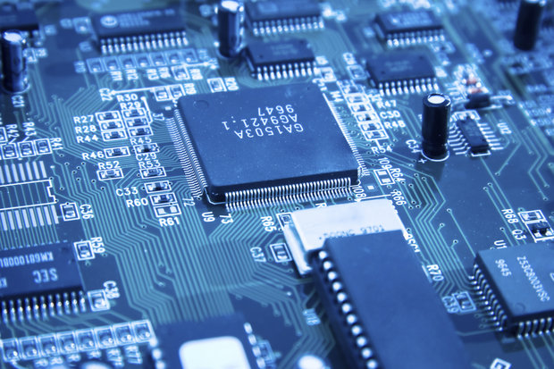
HARDWARE FUNDAMENTALS
HARDWARE
FUNDAMENTALS

Slide 2
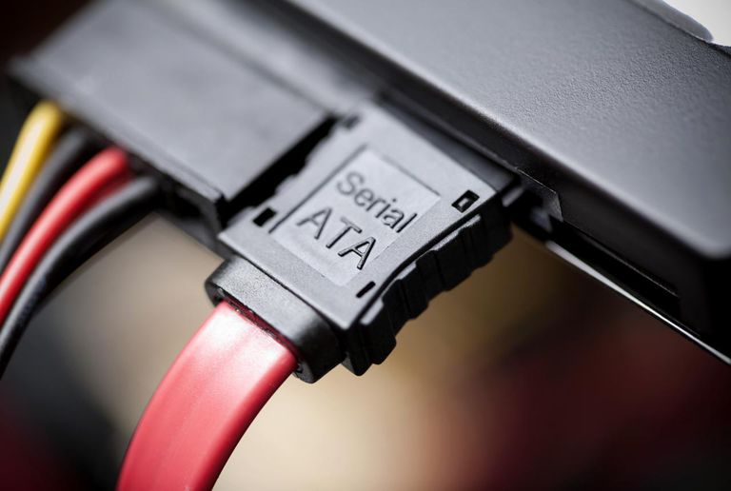
SATA (Serial Advanced Technology Attachment)
Sata is a type of cables and connections.
Used for connecting devices like optical drives and hard drives to the motherboard.
Supports speeds from 187.5 MB/s to 1,969 MB/s.
Sata is Hot Swappable.

Slide 3
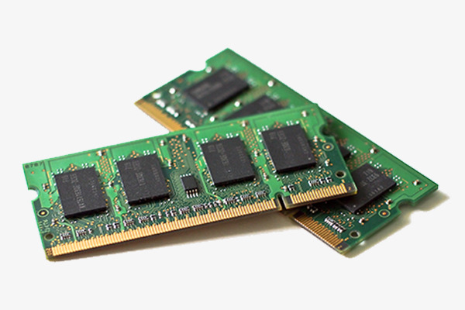
RAM (Random Access Memory)
Ram is placed in computing devices.
Operating system, Application
programs and data in current use
are stored in ram.
RAM is much faster to read from and write to than other kinds of storage in a computer

Slide 4
TYPES
RAM
SRAM
DRAM
SRAM stands for (Static Random Access Memory)
DRAM stands for (Dynamic
Random Access Memory)

Slide 5
SRAM & DRAM
SRAM
DRAM
Retains data bits in its memory as long as power is being supplied and uses transistor to store.
SRAM does not have to be periodically refreshed.
Static RAM provides faster access to data and is more expensive.
SRAM is used for a computer's cache memory
DRAM uses a capacitor to store each bit of data.
DRAM need to be periodically refreshed.
Dynamic Ram provides faster access to data and is less expensive.
DRAM is used for a computer’s main memory

